Slide 1
Verilog Quick Tutorial

Slide 2
Introduction to CAD Tools

Slide 3
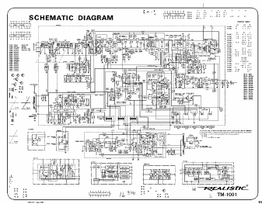
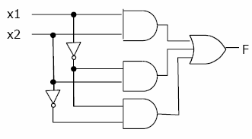
Need for CAD Tools
We’ve seen basic examples of synthesizing logic expression/equation to logic circuit
Very simple circuits (10’s of gates)
Today’s systems consist of millions of gates
Not feasible to manually design these systems

Slide 4

Number of Choices Available
Most systems designed with help of CAD (Computer-Aided Design) Tools
Usually packaged into a CAD system to perform tasks such as
Design Entry, Synthesis, Optimization, Simulation, Physical Design, Verification,
and so on …
Many different companies/tools exists today

Slide 5
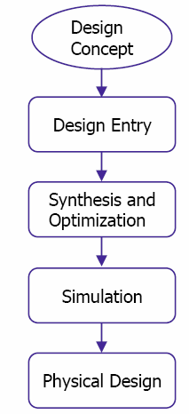
Design Flow
Very basic design flow
Design Entry
Synthesis and Optimization
Simulation
Physical Design

Slide 6
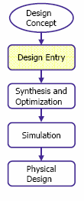
Design Entry
Design Concept
What is the circuit supposed to do?
Design Entry
General structure of how circuit performs desired function
Typically performed by designer
Design entry methods
Truth tables
Schematic Capture
Hardware Description Language

Slide 7
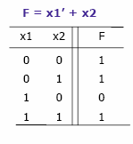
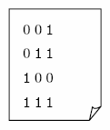
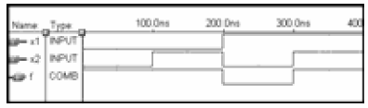
Design Entry with Truth Tables
Design entry using truth tables
Text file
Waveform Editor
Practical only for small designs or sub-circuits

Slide 8
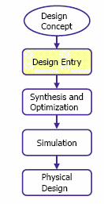
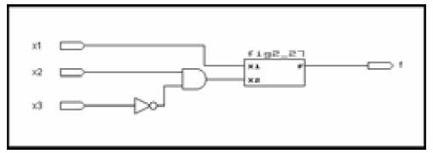
Design Entry with Schematic Capture
Design entry using schematic capture
Graphical tool where designer uses mouse to draw circuit diagram
Library of basic gates designer chooses from
Designer specifies interconnections
Enables hierarchical design
Smaller circuits represented by graphical symbol and used in larger circuits
Compared to truth tables, better for larger designs
Still has limitations

Slide 9
Design Entry with HDLs
Design entry using HDLs (Hardware Description Language)
Similar to a computer program
Describes underlying hardware implementation
Many HDLs exist, two main ones
Verilog
VHDL (Very High Speed Integrated Circuit HDL)
Advantages
Widely supported
Enables portability
Underlying implementation can differ without having to change the design specification
Text-based
Easy to include in documentation
Modular implementation possible
Enables hierarchical implementation of circuits
Sharing and re-use

Slide 10
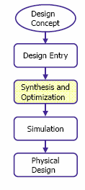
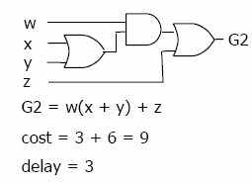
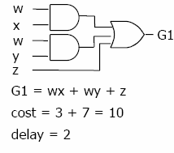
Synthesis and Optimization
Synthesis performed by CAD tool
Translate design entry into intermediate format
We assume logic function (for simplicity)
Realistically intermediate formats vary depending on tool
Likely designer did not optimally specify design
Logic synthesis or logic optimization performed by synthesis tool
Important task of manipulating user’s design to produce equivalent, but better circuit
What makes circuit “better”?
Size/area, performance, cost, etc …

Slide 11
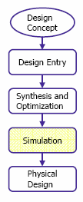

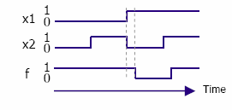
Functional Simulation
How do we know our design actually works?
Functional Simulation
Method
Designer provides input values
Functional simulator applies these values to the equations
Functional simulator produces correspond outputs
Truth table or timing diagram
User examines output to verify design
Gate Delay
Functional simulator assumes delay negligible
Timing simulator accounts for timing details related to a specific technology

Slide 12
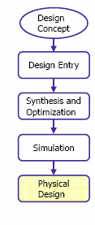
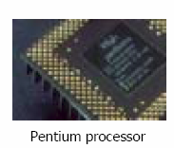
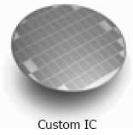
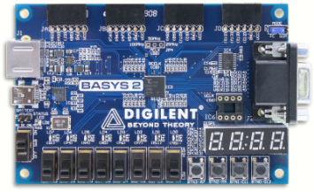
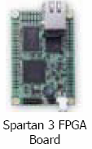
Physical Design
Physical Design is a type of synthesis
Sometimes referred to as layout synthesis
Implement the intermediate format into a technology dependent format
F = (a+b)’ (cd+a’b) + a’c + bcd
Basys2 FPGA

Slide 13
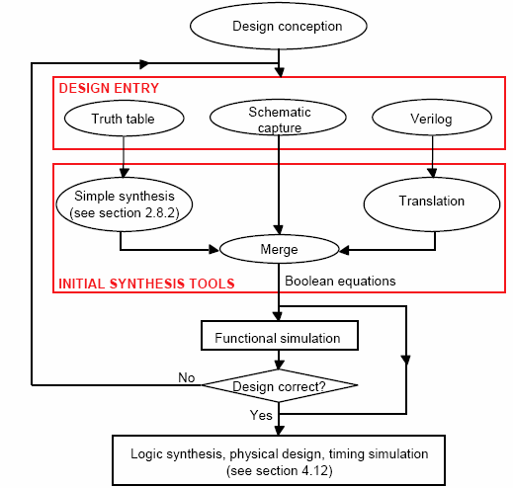
Expanded Design Flow
Expanded design flow
Preliminary stages
Designer can use mixture of design entry methods
Automatically merged into one specification
Iterative process

Slide 14
C++
C++ as an hardware modeling language is excellent choice for “high-level" behavioral analysis of a system (like evaluating different data flow architectures in a microprocessor).
However C++ lacks the basic hardware concepts like knowledge of strengths, connections, and concurrent execution which complicates model generation for lower level simulations.

Slide 15
VHDL
VHDL is good for designing Behavioral models
Incorporates some of the modern object oriented techniques.
It's syntax is strange and irregular, and the language is difficult to use.
Structural models require a lot of code that interferes with the readability of the model.

Slide 16
Why Verilog?
Verilog is a great low level language.
Structural models are easy to design and Behavioral RTL code is pretty good.
The syntax is regular and easy to remember.
It is the fastest HDL language to learn and use.
However Verilog lacks user defined data types and lacks the interface-object separation of the VHDL's entity-architecture model.

Slide 17
Verilog Programming

Slide 18
Modules
In Verilog, circuit components are designed inside a module.
Modules can contain both Structural and Behavioral statements.
Structural statements represent circuit components like logic gates, counters, and microprocessors.
Behavioral statements are programming statements that have no direct mapping to circuit components like loops, if-then statements, and stimulus vectors which are used to exercise a circuit.

Slide 19
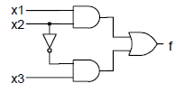
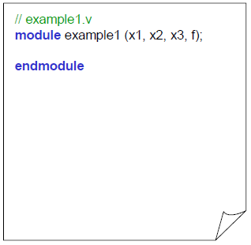
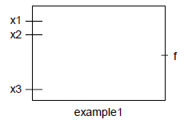
Example of Logic module
Lets implement a sample circuit
Module indicates the
start of our specification, end module indicates the end of it
We now have a black box named “example1”
Black box has 4 ports: x1, x2, x3 and f

Slide 20
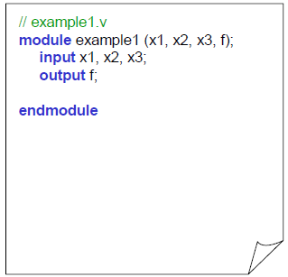
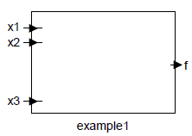
Example of Logic module
We now specify which ports are inputs and which one are outputs

Slide 21
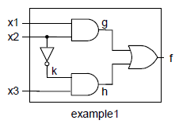
Example of Logic module
/////////////////////////////////
// Module Name: example1
/////////////////////////////////
module example1(x1, x2, x3, f);
input x1, x2, x3;
output f;
assign f = (x1 & x2) + (x3 & ~x2);
endmodule
If we know the output function directly in terms of inputs we can implement a “behavioral” model of the circuit
assign keyword indicates anytime something changes on
right hand side, re-evaluate left hand side

Slide 22
Major Data Types
Nets
Registers
Parameters

Slide 23
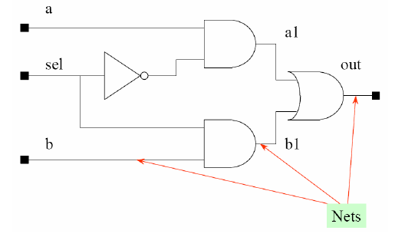
Nets
Net data type represent physical connections between structural entities.
A net must be driven by a driver, such as a gate or a continuous assignment.
Verilog automatically propagates new values onto a net when the drivers change value.

Slide 24
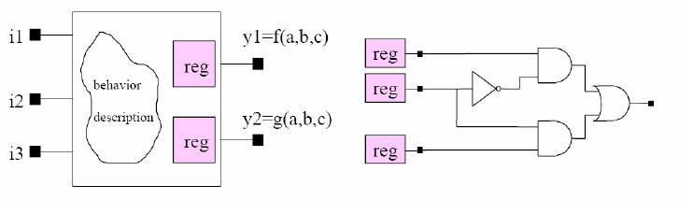
Registers
Registers represent abstract storage elements.
A register holds its value until a new value is assigned to it.
Registers are used extensively in behavioral modeling.

Slide 25
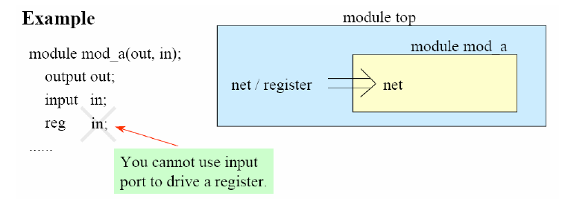
Common mistake in choosing data type
An input port can be driven by a net or a register, but it can only drive a net.

Slide 26
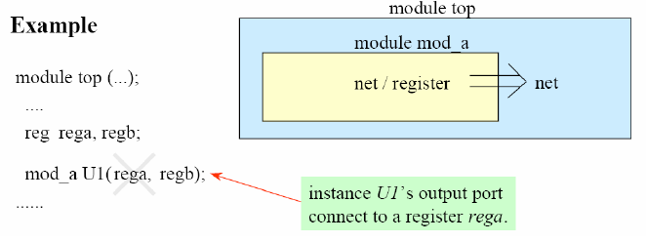
Common mistake in choosing data type
An output port can be driven by a net or a register, but it can only drive a net.

Slide 27
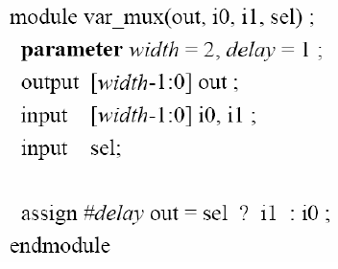
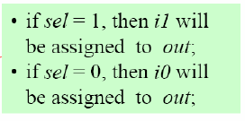
Parameters
Parameters are not variables, they are constants.
Typically parameters are used to specify delays and width of variables.

Slide 28
Types of Modeling
Behavioral
Gate-Level
Structural

Slide 29
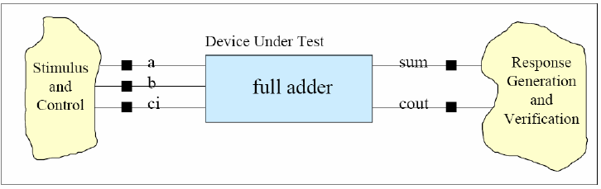
Full Adder Example
module module_name (port_name);
port declarations
datatype declarations
task and function declaration
module functionality and structure
timing specification
endmodule

Slide 30
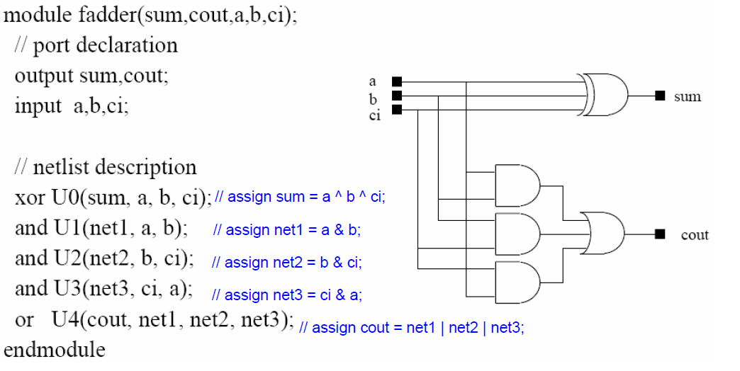
Gate Level Verilog Description
xor, and, or are the primitive gate definitions available in Verilog

Slide 31
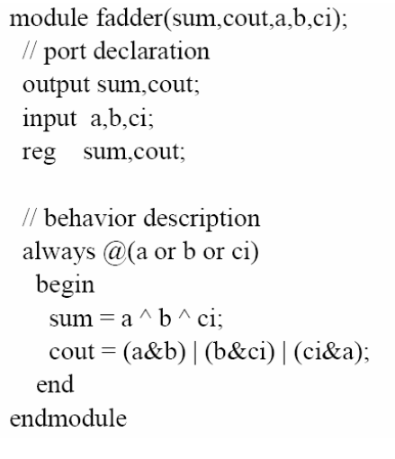
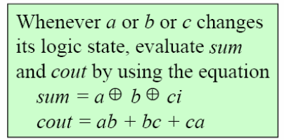
Behavioral Level Verilog Description

Slide 32
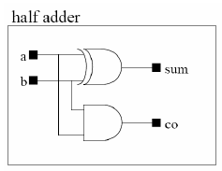
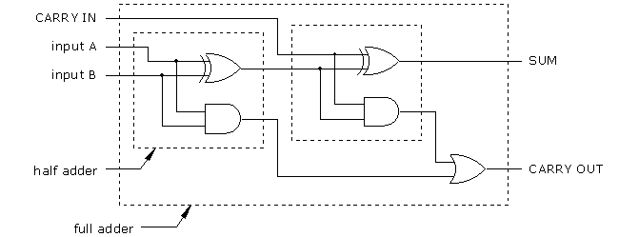
Structural Modeling
In structural modeling, you connect components with each other to create a more complex component.

Slide 33
Structural Modeling
Full Adder
Cin
Sum
S
A
HA
Sum0
c1
Cout
B
HA
c0
module FA (A,B,Cin, Sum,Cout);
input A,B,Cin;
output Sum, Cout;
wire sum0, c0,c1;
HA ha0 (A,B,sum0,c0);
HA ha1 (Cin,sum0,Sum,c1);
assign Cout = co | c1;
endmodule
module HA (a,b,sum,co);
input a,b;
output sum, co;
assign sum = a^b;
assign co = a & b;
endmodule

Slide 34
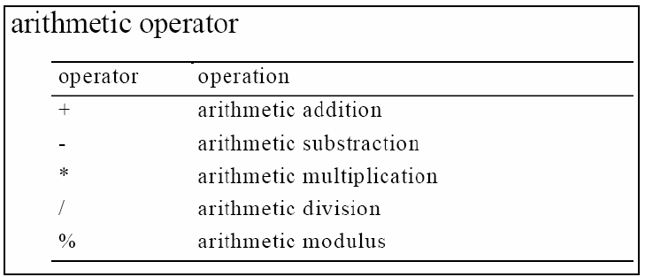
Arithmetic Operations

Slide 35
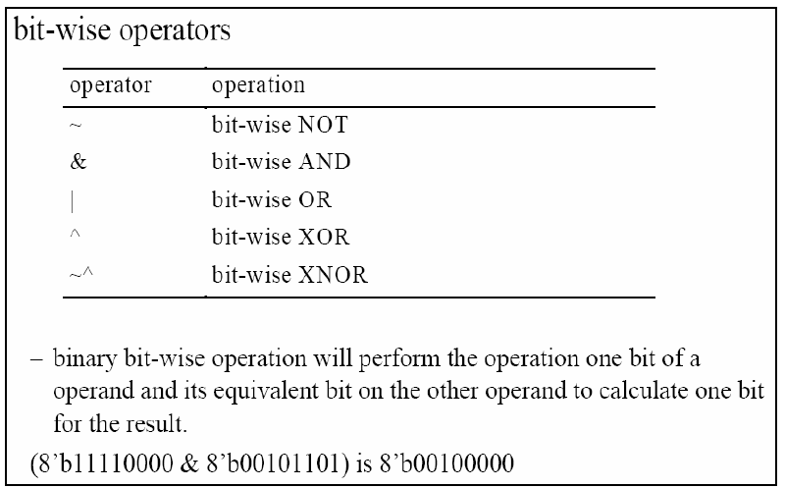
Bit-Wise Operations

Slide 36
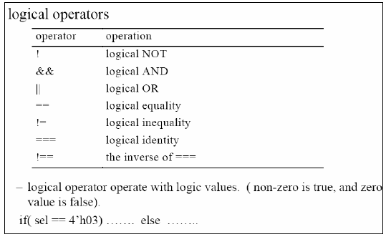
Logical Operations

Slide 37
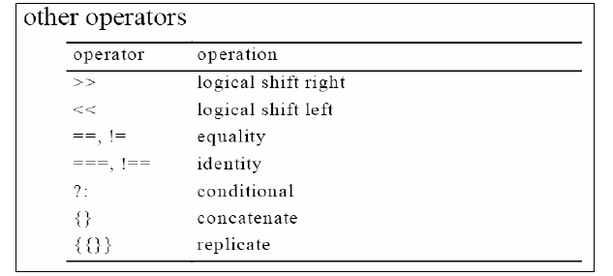
Other Operations

Slide 38
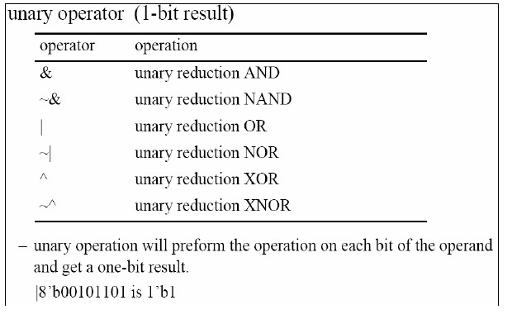
Unary Operations

